Slide 1
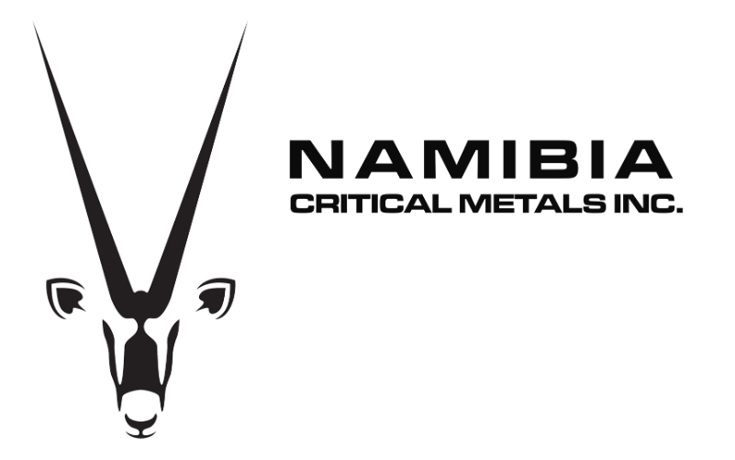
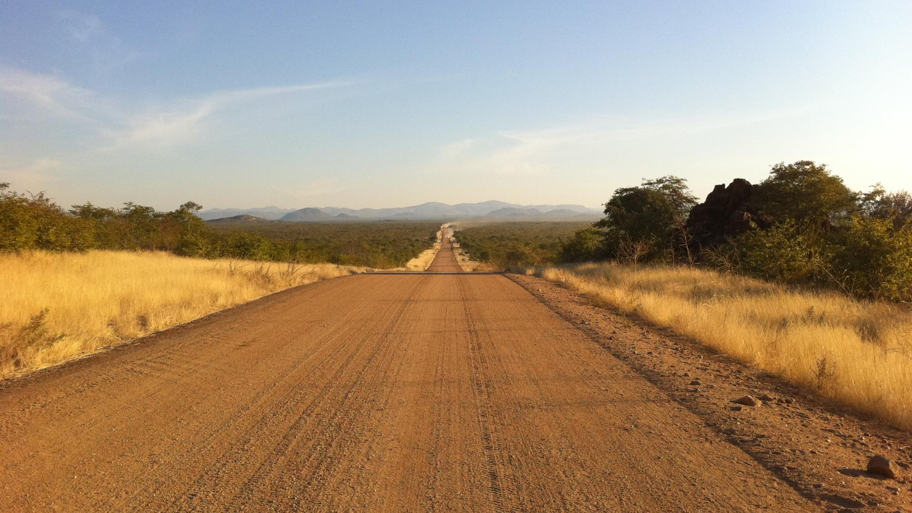
TSX-V: NMI
OTCQB: NMREF
Lofdal - A World-Class
Heavy Rare Earth Deposit in Development
June 2025

Slide 2
Forward Looking Statements
This presentation contains forward-looking statements that relate to the Company's current expectations and views of future events. Rainer Ellmies, EurGeol, is the Company’s Qualified Person and has reviewed and approved the content of this presentation.
In some cases, these forward-looking statements can be identified by words or phrases such as "may", "will", "expect", "anticipate", "aim", "estimate", "intend", "plan", "seek", "believe", "potential", "continue", "is/are likely to" or the negative of these terms, or other similar expressions intended to identify forward-looking statements. The Company has based these forward-looking statements on its current expectations and projections about future events and financial trends that it believes may affect its financial condition, results of operations, business strategy and financial needs. These forward-looking statements include, among other things, statements relating to (i) the Company's strategy, growth, development and acquisition opportunities, return on existing assets, operational excellence and financial management; (ii) the Company's expectations regarding its revenue, expenses and operations; (iii) the Company's anticipated cash needs and its estimates regarding its capital and operating expenditures; (iv) capital requirements, needs for additional financing and the Company's ability to raise additional capital; (v) the Company's estimates of future cash flows, financial condition and operating performances of the Company and its subsidiaries; (vi) the estimation of any mineral resources and the realization of mineral reserves based on mineral resource, estimates and estimated future development, if any, and possible variations of ore grade or recovery rates; (vii) estimated results of planned exploration and development activities; (viii) the Company's competitive position and its expectations regarding competition from other companies globally; (ix) the Company's ability to maintain customer and supplier relationships; (x) anticipated trends and challenges in the Company's business and the markets in which it operates, including with respect to potential new rare earths projects, supply outlook and growth opportunities; (xi) limitations of insurance coverage; (xii) the future price of and future demand for rare earths elements and their derivative products; (xiii) economic and financial conditions; (xiv) interest rates and foreign exchange rates; (xv) performance of counterparties in fulfilling their obligations; (xvi) government regulation of mining operations, accidents, environmental risks, exploration risks, reclamation and rehabilitation expenses; (xvii) title disputes or claims; and (xviii) the timing and possible outcome of pending regulatory and permitting matters.
Forward-looking statements are based on certain assumptions and analyses made by the Company in light of its experience and perception of historical trends, current conditions and expected future developments and other factors it believes are appropriate. These assumptions include continued political stability in Namibia, that permits required for the Company's operations will be obtained in a timely basis in order to permit the Company to proceed on schedule with its planned drilling programs, that skilled personnel and contractors will be available as the Company's operations continue to grow, that the price of rare earths will remain at levels that will render the Company's projects economic and that the Company will be able to continue raising the necessary capital to finance its operations. Forward-looking statements involve a variety of known and unknown risks, uncertainties and other factors, including those listed under the heading "Risk Factors" in the Company’s Annual Financial Report dated November 30, 2024 (filed on SEDAR www.sedar.com), which may cause the Company's actual results, performance or achievements to be materially different from any future results, performances or achievements expressed or implied by the forward-looking statements.
The forward-looking statements made in this presentation relate only to events or information as of the date on which the statements are made in the presentation. Except as required by law, the Company undertakes no obligation to update or revise publicly any forward-looking statements, whether as a result of new information, a future event or otherwise, after the date on which the statements are made or to reflect the occurrence of unanticipated events.
There can be no assurance that such forward looking information will prove to be accurate, as actual results and future events could differ materially from those anticipated in such information. Accordingly, potential investors should not place undue reliance on forward-looking information.

Slide 3
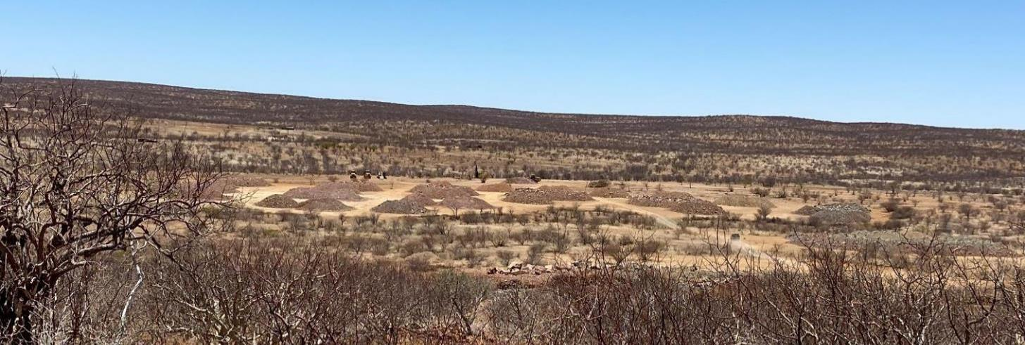
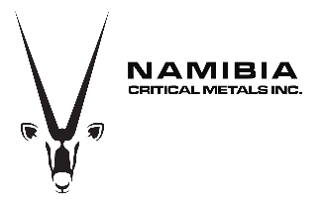
The Lofdal Story
Namibia Critical Metals: Tier-1 Heavy Rare Earths in Development
Dy
Dysprosium
Tb
Terbium
Globally Significant Heavy Rare Earth Metals Deposit
Fully Permitted Lofdal Project with 25 Year Mining License
Development Funded under JV with Japanese Government/JOGMEC
Namibia – Top Investment Destination in Africa
TSXV:NMI
OTCQB:NMREF

Slide 4
Company overview Namibia Critical Metals (NMI)
Incorporated in 2011
Formed by spin out from Etruscan Resources during sale to Endeavour Mining
Listings Toronto TSX Venture Exchange (“NMI”), New York OTCQB(“NMREF”)
Head Office Halifax, Nova Scotia
Operations Office Windhoek, Namibia
Shares Issued 217,824,875
Insider Ownership 22%
Single Largest Shareholder 43% Bannerman Energy, ASX:BMN
Market Capitalization CAD10 million (June 2025)
Namibia Critical Metals Inc.
Canada
100%
Namibia Rare Earths Cayman Inc. Cayman Islands
95%
PhilCo 196 (Pty) Ltd
Namibia
5%
Namibia Rare Earth (Pty) Ltd
Namibia
100%
Mining License ML200

Slide 5
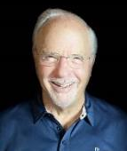
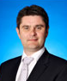
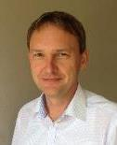
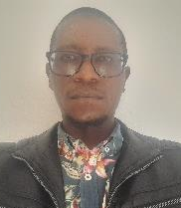
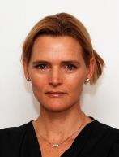
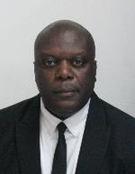
Corporate and in-country team with strong track record
William L. Price, Chair
Mr. Price is the former Chairman and Global Chief Investment Officer of Dresdner RCM Global Investors and CIO for equities at Allianz Dresdner RCM. He has served as a corporate director of several publicly traded companies. Mr. Price worked for the US Department of State before going to Wall Street as a securities analyst. He joined Rosenberg Capital Management in 1976 and became Chairman and CEO in 1996. For fifteen of those years, he was a guest lecturer at the Graduate School of Business at Stanford University.
Darrin Campbell,
B.Com, CPA-CMA, President
Mr. Campbell is a Chartered Professional Accountant and Certified Management Accountant with 20 years of executive financial management experience. He played key leadership roles in financings and transactions taking companies public onto the TSX-V. From 2013-2014 he was the CFO of Ressources Appalaches and was the financial leader bringing into production Nova Scotia’s first operating gold mine in over 14 years. Mr. Campbell obtained a Bachelor of Commerce from Saint Mary’s University in 1996 and is a member of the Chartered Professional Accountants of Nova Scotia.
Rainer Ellmies, PhD, MSc, GeolFA, EurGeol, AusIMM Vice President Exploration
Dr. Ellmies is based in Windhoek and provides all in-country management. He develops the company’s geological concepts and exploration strategies and implements those with our dynamic exploration teams in Namibia. Dr. Ellmies has a broad background with over 30 years experience in academics, exploration, international development cooperation. He has been directly involved in a number of significant discoveries in Namibia and internationally including the Lofdal HREE, Opuwo Cobalt, Ondoto LREE and Epembe Ta-Nb deposits.
Gideon Kalumbu,
BScGeol, MScGeol
Chief Geologist
Mr Kalumbu is a geologist based in Namibia. Over his 15 years tenure in mineral exploration, Gideon continues to support the company’s management in the execution of projects ranging from geological field work to project management. He has been responsible for the site management of exploration work on a number of projects such as the Lofdal HREE Project and the Opuwo Cobalt Project. Gideon also acts as Radiation Safety Officer for the Lofdal Project.
Barbara Mulcahy, B.Eng, PR.Eng Metallurgical Advisor
Based in South Africa, Barbara has 25 years experience in the metallurgical consulting, project process engineering design & development and research sectors. Her experience includes metallurgical project development from geology and mine development through to ore dressing and refining, process engineering design and project development.
Uda Nakamhela, B.A. LL.M. Legal, Environment, Community Relations & Governance
Mr. Nakamhela has over 20 years of experience in ESG in the Namibian exploration, mining and tourism sectors.
Mr. Nakamhela has been a Legal Practitioner of the High Court of
Namibia since 29 July 2002. From 2003 to 2005 he worked as coordinator of the Community Based Natural Resource Management Unit for the Namibia Nature Foundation.

Slide 6
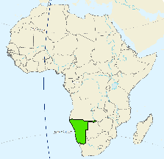
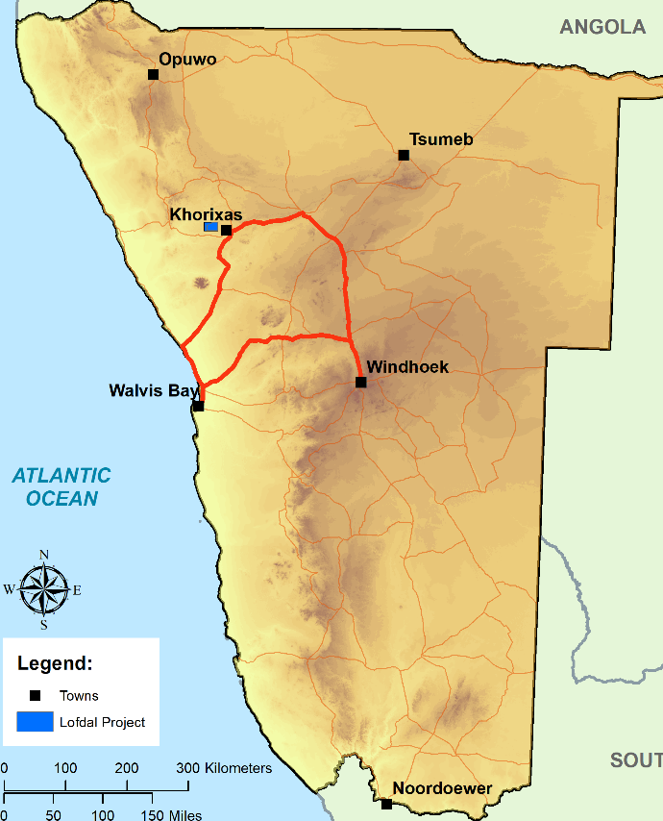
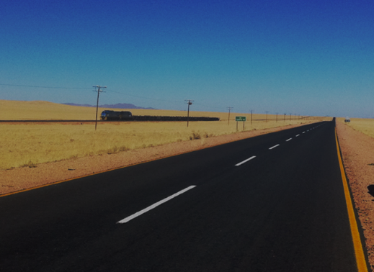

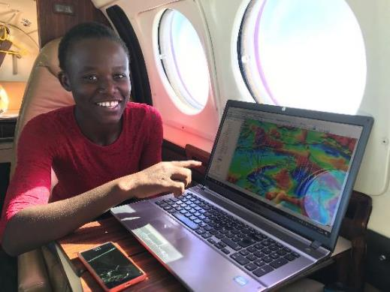
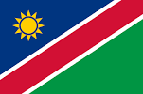
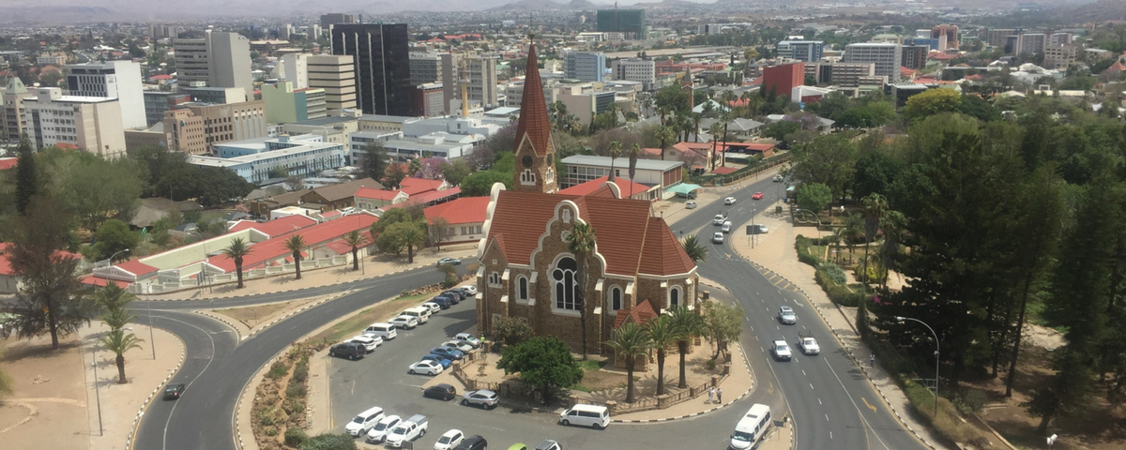
Namibia – Top mining investment destination in Africa
Socially and politically stable
Mid-income country
Strong rule of law
Mining friendly
No.26 in Fraser Institute Policy Perception Index (2022)
49 points in Corruptions Perception Index like Greece (Hungary 43, Turkey 38)
Strong industry lobby group - Chamber of Mines of Namibia
Mining License ML200 Lofdal
Excellent infrastructure
Harbour
Strong support by Geological Survey of Namibia

Slide 7
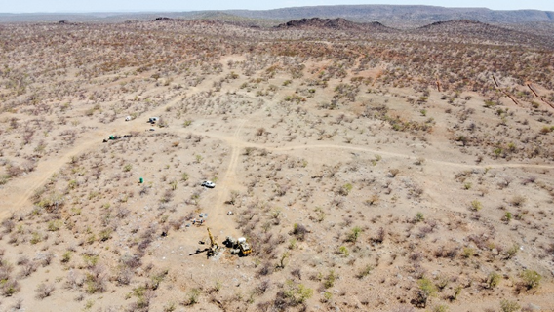
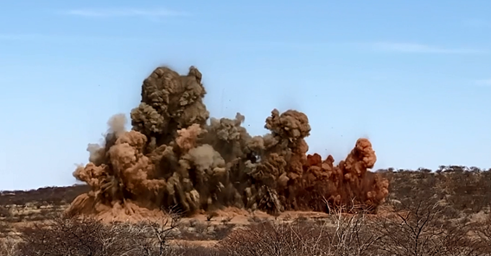
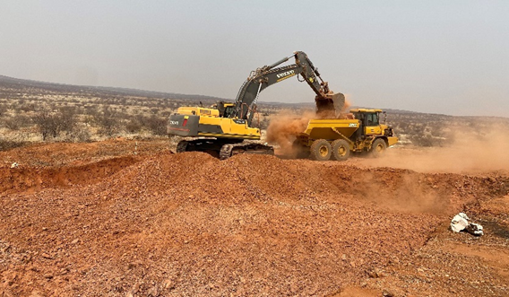
Exploration and Project Development from 2020
Namibia Rare Earths spun out from sale of Etruscan Resources to Endeavour Mining with $28M IPO
Maiden Resource: 6.2 Mt Indicated & Inferred
2014 PEA Lofdal Area 4: 1500 t/a TREO production over 6 years mine life; Capex $175M; NPV $240M; IRR 53% pre-tax
Joint Venture Agreement with Japan Organization for Metals & Energy Security (JOGMEC) for development and operation of Lofdal HREE mine
16,000 m drilling, detailed metallurgical test work
Mineral Resource Estimate Area 4 + Area 2B:
  44.8 Mt Measured & Indicated
Mining Licence received (valid until 2046)
Starter pit and pilot scale metallurgical test work
Positive PEA for significantly expanded project Lofdal 2B-4
Commencement of PFS Lofdal 2B-4
Updated Mineral Resource Estimate Area 4+2B: 55.8 Mt Measured & Indicated
Optimization of metallurgy on pilot-scale
Thorium Off-Take MOU with Copenhagen Atomics
2025 Pilot scale flotation and hydromet test work completed – PFS in October 2025
Expenditures NRE/NMI 2008-2019 CAD24,000,000
Expenditures JOGMEC JV 2020-2024 CAD16,745,000
TOTAL PROJECT EXPENDITURES TO DATE CAD40,745,000

Slide 8
Updates & Advancements Over the Last Year
NI 43-101 Mineral Resource Update April 2024
  - 31% increase in Measured & Indicated contained TREO to 94,000 tonnes
  - 12% increase in Measured & Indicated contained tonnes Dy (4503 t) and Tb (693 t)
  - Still significant exploration upside
Flotation Pilot Plant Test Work Completed
  - 5 tonne flotation pilot plant tests completed
  - Produced 100 kg concentrate for hydrometallurgical pilot test work
  - Confirmed the reproducibility of the grinding and flotation regime flowsheet and ability to scale-up
√ Hydrometallurgical Pilot Test Work Completed
  - Optimization test work should lead to reduced opex from PEA
  Value Engineering Proceeding to Optimize Economics for PFS
  Secured Long-Term Access Agreements with all Community Stakeholders
Dysprosium

Slide 9
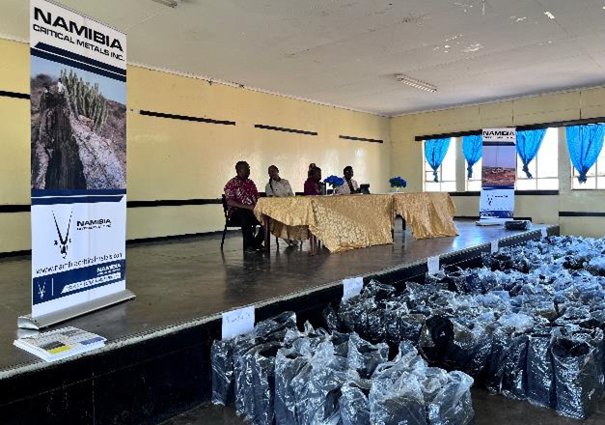
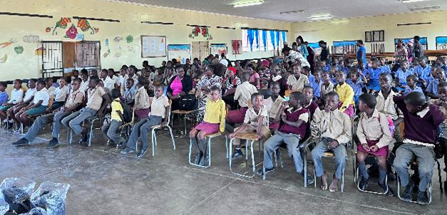
Updates & Advancements Over the Last Year
JOGMEC Earns 40% Interest in Lofdal Project by spending $10 Million CAD
  - JOGMEC advances to third and final Term to earn additional 10% interest by spending additional $10 Million
  - Total JOGMEC Expenditures to date - $16,745,000
CSR
- Early Learner‘s Assistance Program - Hand-over of 204 sets of school uniforms and bags in February 2025
  - Long-term Access and funding Agreements secured with the 2 Traditional Authorities and 2 Conservancies for the Lofdal project
  Pre-Feasibility Study on Track for delivery in October 2025
  - SGS Bateman: Lead, Engineering MSA: Geology & Resource
  - SRK: Geotechnical Qubeka: Mine Plan and Reserves
  - CREO: Infrastructure SGS Lakefield: Metallurgy
  - Knight Piesold: Tailings
Dysprosium

Slide 10
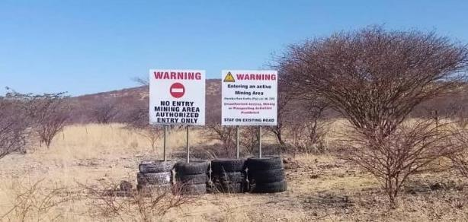
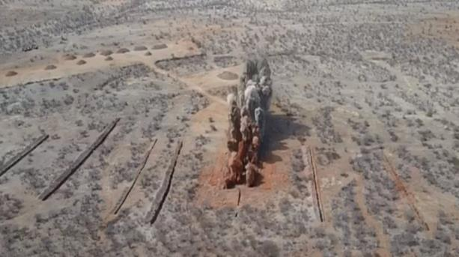
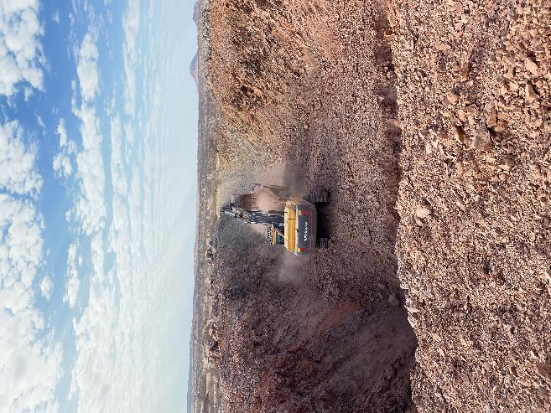

Legal: Mining License and JOGMEC JV
Mining License ML200 granted by signature of the Minister of Mines and Energy on 15 July 2021 for 25 years (until 14 July 2046)
License needs certain requirements to be fulfilled like commencement of mining and processing
Agreement with Japan Organization for Metals and Energy Security (JOGMEC) to jointly develop the Lofdal HREE project signed in February 2020:
First term commitment of CD$3M to double resource size and advance metallurgical flowsheet;
Second term option to fund CD$7M to acquire 40% interest;
Third term option to fund CD$10M to acquire additional 10% interest;
Option to purchase 1% for CD$5M to reach 51%;
Right to fully fund to production and offtake at market prices
NMI may be diluted to a carried working interest of no less than 21% by paying CD$5M for the dilution protection or elect to participate at 44%
5% interest is mandated to be held by Historically Disadvantaged Namibians

Slide 11
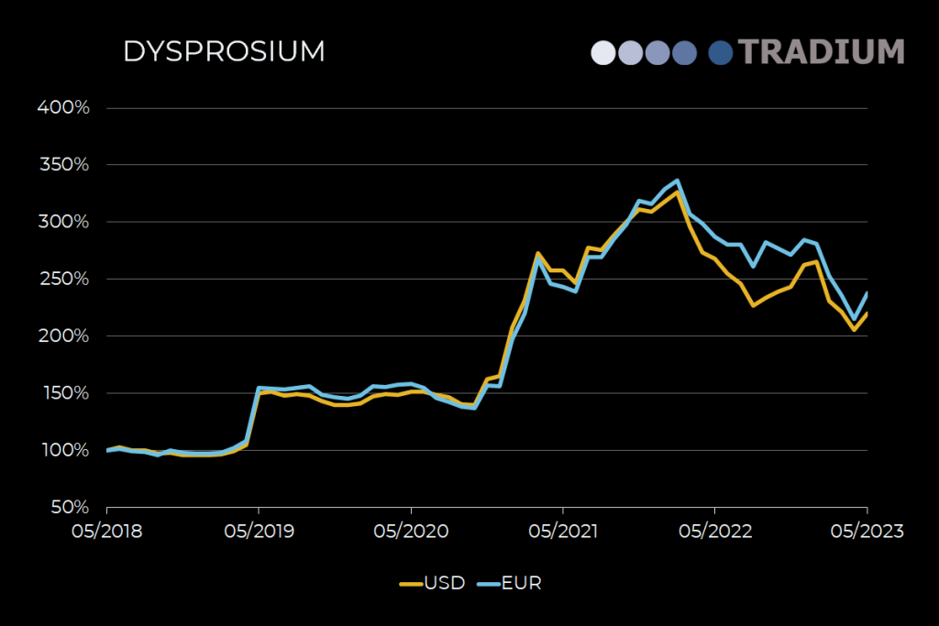
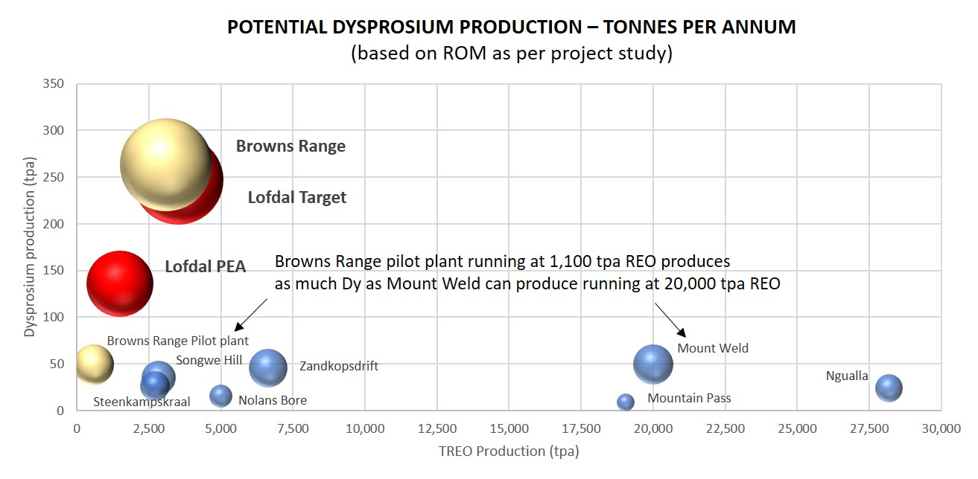
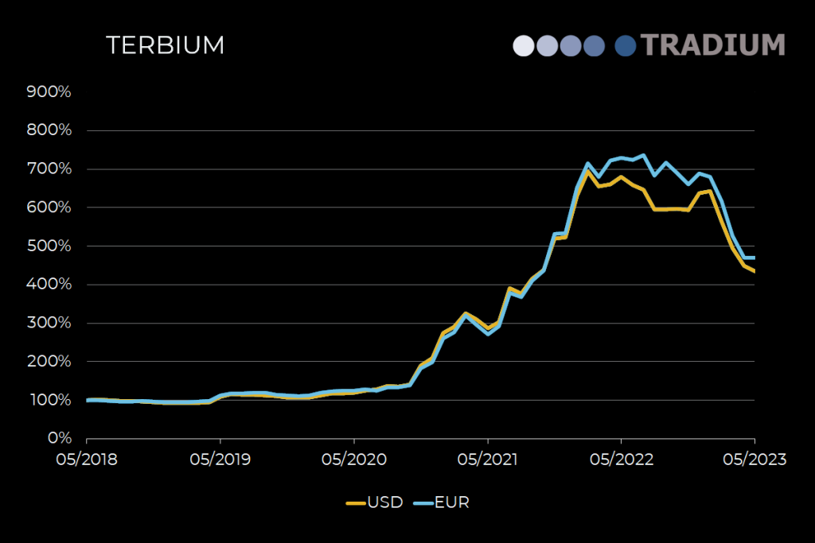
Lofdal Deposit Significant for Global HREE Supply
The only two significant HREE projects in the world with simple xenotime mineralogy are Lofdal and Browns Range (Australia).
Note: NMI is targeting to increase annual production from 2,000 tpa TREO (“Lofdal PEA”) to 3,000 tpa TREO (“Lofdal Target”)

Slide 12

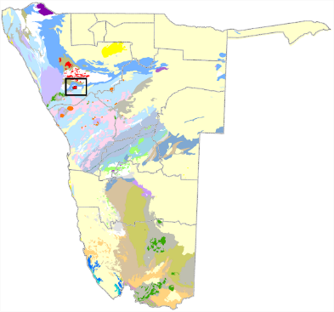
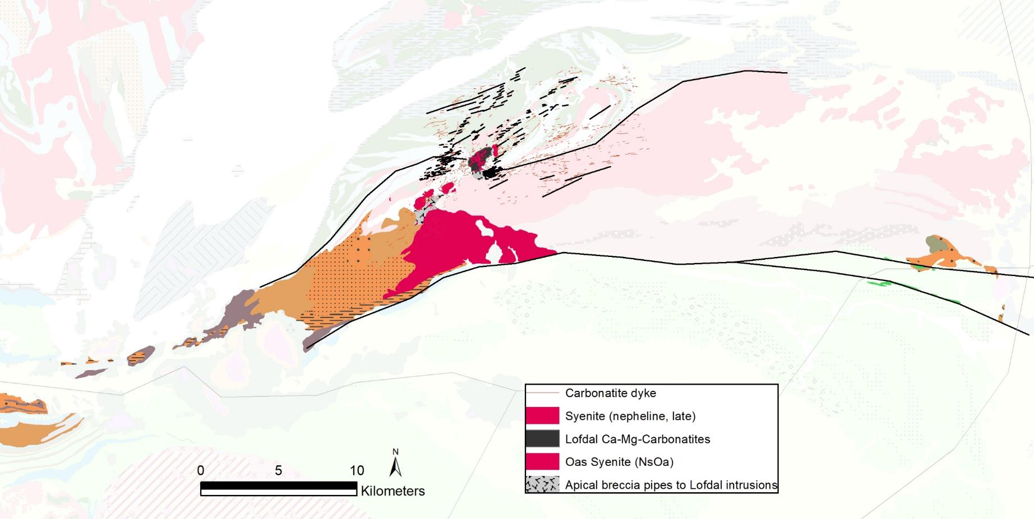
Regional-scale HREE mineralization at Lofdal
Lofdal HREE deposit
District-scale, hydrothermal, structurally controlled xenotime mineralisation
Lofdal
Structural control: Repeatedly re-activated fault zones as fluid channels for HREE-rich fluids from deep intrusion
Mineralisation controlled by compres-sional structures, step over zones
Alteration: Albitization and intense brecciation of albitite (rheological control) in fault zones
Windhoek
Lofdal Intrusive Complex
Nepheline syenites, phonolite dyke swarm,
Ca- and Mg-carbonatites, diatremes
Khorixas-Gasenairob Fault
(reactivated rift structure)
Khorixas
Oas Alkaline Complex
Syenite, quartz syenite
(756 +/- 2 Ma Hoffmann et al., 1996)

Slide 13
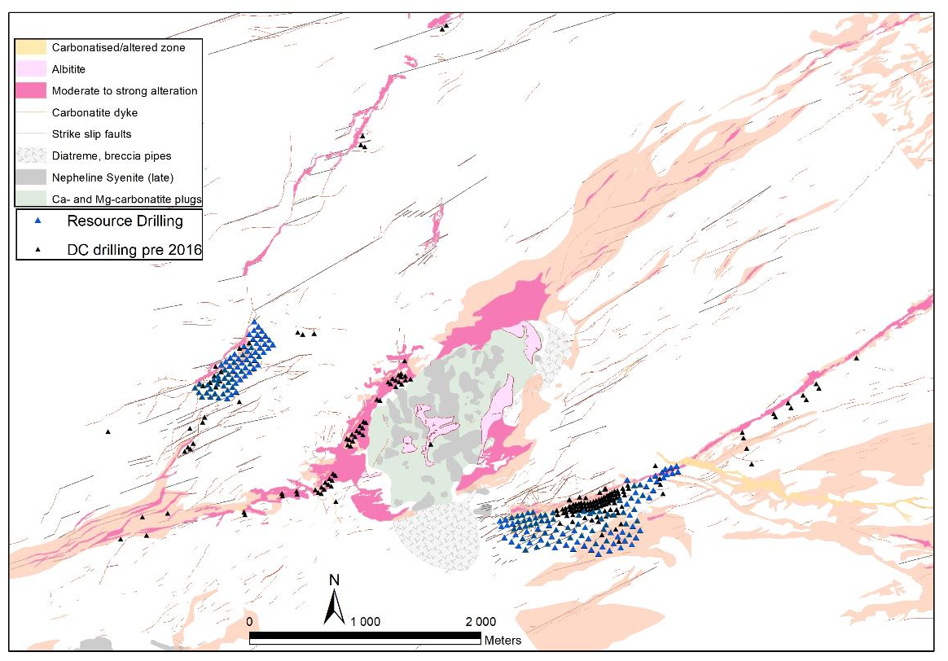
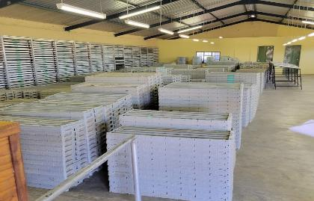
Drilling
Focus on resource drilling at Area 4 and Area 2B
Mineral Resource Statement of May 2024 only refers to the segments of Area 4 and Area 2B
Large additional resource upside potential
Total of 56,771 m drilled throughout project
Central sample storage in Khorixas
Area 2E
Area 1
Area 2D
Area 2C
Area 2B
Area 2A
Area 5
Area 4
Central Lofdal deposit

Slide 14
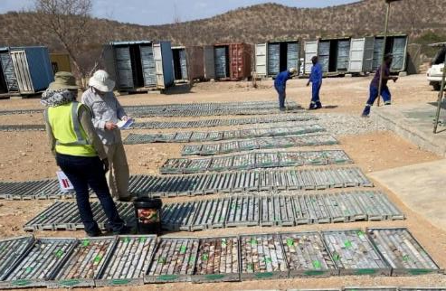
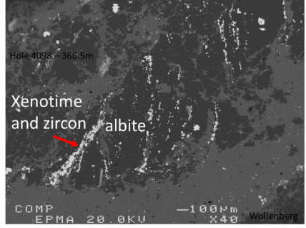
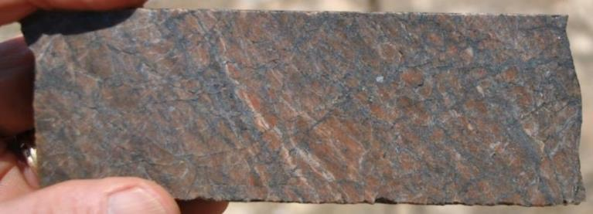
HREE ore zones in Area 4 and Area 2B
Continuous HREE zones to depth, dip generally 50-55°SSE
Thickness between 10 and 40 m
No zonation observed to depth of -400 m
Hydrothermal infusion of intense fracture fabric in albitite → „veinlet-infused-albitite micro-breccia” is most typical form of economic HREE mineralisation; veinlets of xenotime-calcite-biotite-chlorite-albite-apatite-thorite-zircon
Subhedral xenotime (Y,HREE)PO₄ is the principle HREE mineral. Other HREE mineral phases, like yttrialite (Y,Th)₂Si₂O₇, can make up to 20% of the HREE content
LREE in fluorocarbonates synchisite etc. and monazite
Section through central Area 4 with HREE grade block model
Late calcite vein
Wollenberg, 2015
Xenotime mineralisation at 100 µm scale (left), core yard at Khorixas
Veinlet infused mottled albitite breccia with tan overprint

Slide 15

Mineral Resource Statement 2024
Mineral Resource Estimate by The MSA Group (May 2024)
Combined Area 4 and Area 2B Measured and Indicated Mineral Resource of 58.5 Mt at 0.16% TREO at a cut-off of 0.1% TREO
Critical HREO contained over all resource categories: 5,440 t Dy₂O₃ and 745 t Tb₂O₃
Contained dysprosium oxide and terbium oxide in Mineral Resources of 2021 and 2024 (*TREO = Total Rare Earth Oxides and includes Y₂O₃ )
Full report at: www.sedar.com

Slide 16
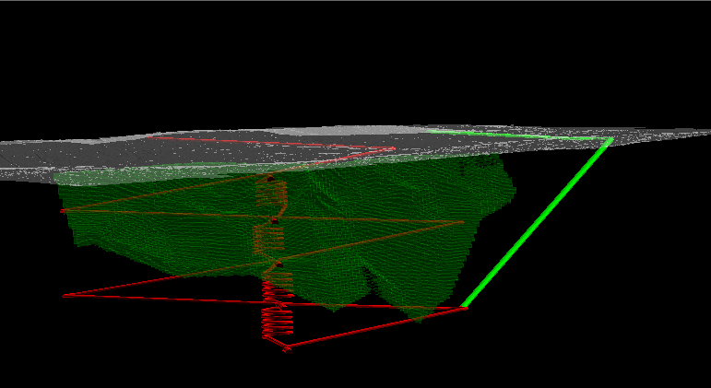
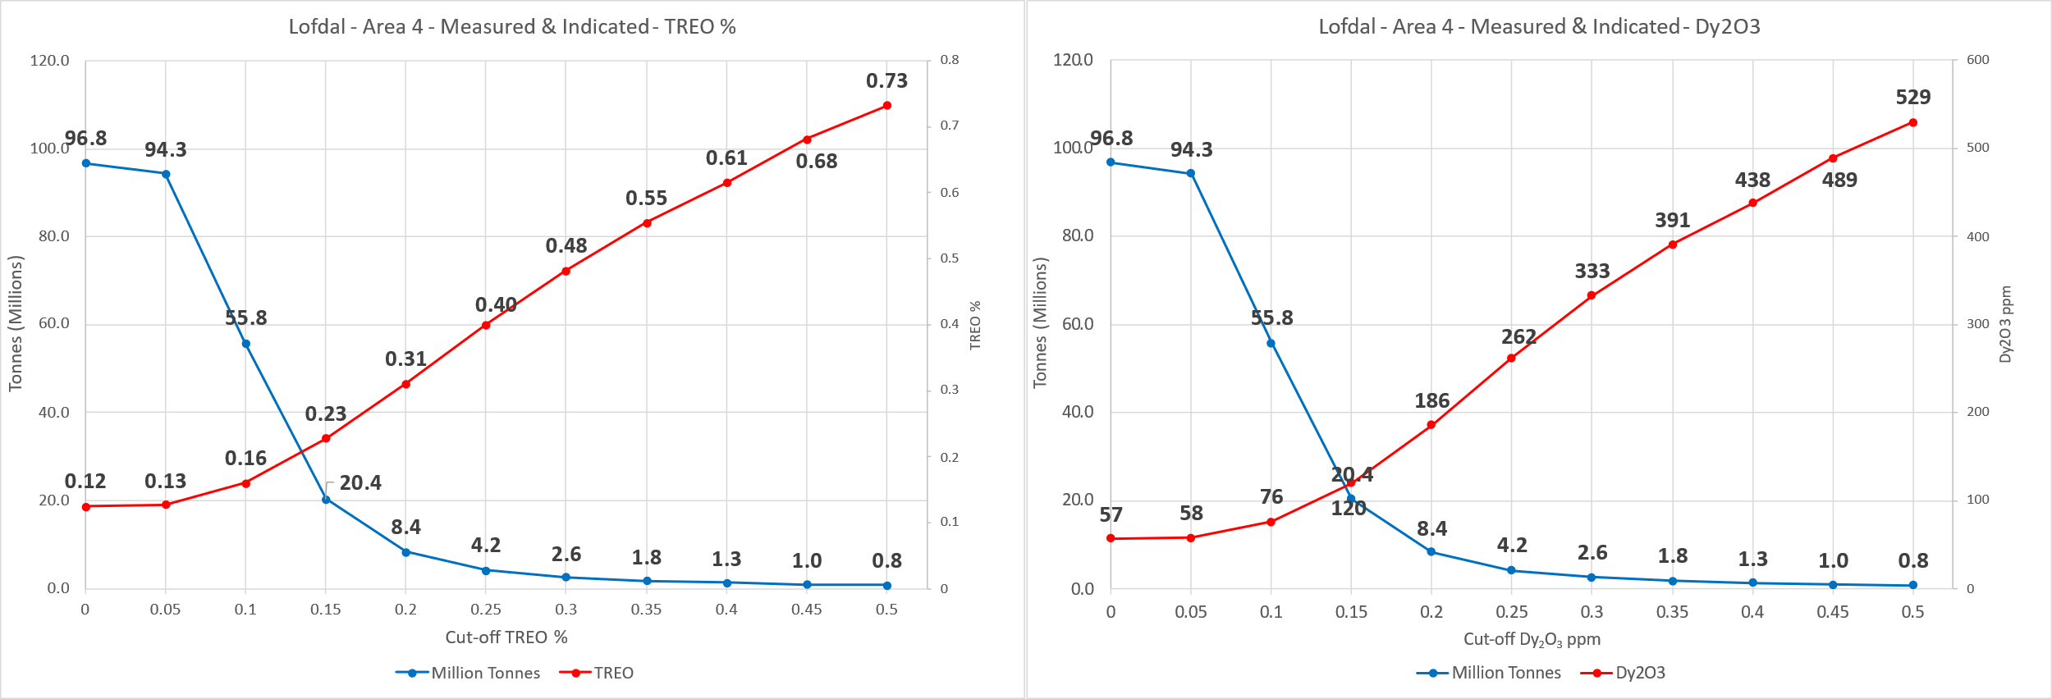
Resource upside potential in lower grade material
Most of mineralisation is in low grade material around 0.1% TREO. Only with inclusion of low grade mineralisation, Lofdal Mine reaches the goal of large product output combined with long mine life.
Massive upside exist if underground mining will be considered
Exploration target for 0.14-0.16% TREO material is 150-200 Mt.
Underground study incorporates initial open pit then transition to underground mining to 600 vertical meters
Large upside in low-grade material
Average grade 0.16% TREO in 2024 NI43-101 Resource for 55.8 Mt
Grade-Tonnage-Curves for Measured and Indicated Resources, Dy2O3 (in ppm)

Slide 17
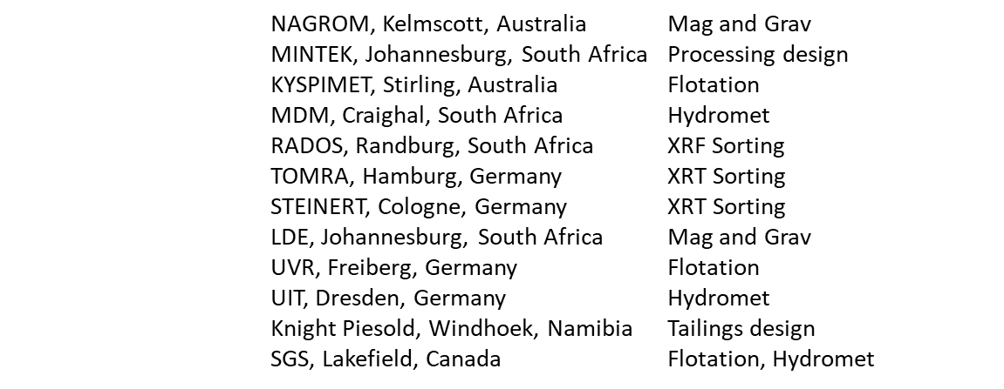

Processing flowsheet for “Lofdal 2B-4”
Intensive test work for 10 years
Fine grained xenotime is challenge (liberation at <53µm)
Flotation is key in processing, developed with >160 individual flotation tests
Hydrometallurgy: Caustic crack route excluded, acid bake is efficient
Groups of international specialists involved in the processing flowsheet:
Lead consultant: SGS Lakefield/SGS Bateman Johannesburg
Mining 2.1 Mt/a
Milling
Acid Bake
Water leach and impurity removal
Th and U removal
REE-precipitation
Calcination (>98% TREO)
Crushing
Flotation
Target MREO production:
2000 t >98% TREO (with 86% HREO)

Slide 18
Preliminary Economic Assessment (PEA) Lofdal “2B-4”
Total run of mine 26.8 Mt (+13.9 Mt in stockpile)
Mine life: 16 years
Average Annual Production: 2,000 t TREO including
117 t Dysprosium and
17.5 t Terbium
Net Present Value NPV (5): 632.7 Million USD pre-tax,
              391 Million USD after tax
Internal Rate of Return (IRR): 34% pre-tax and 28% after tax
Initial Capital Costs: 207 Million USD incl. 30% contingency
Capital Payback Period: 3.2 years after tax
OPEX 27.9 USD/t
Price for Rare Earth Oxides used: Dy2O3 USD587/kg and Tb2O3 USD2,493/kg
Average basket price of USD91/kg including third party separation costs
13.9 Mt of low-grade stockpile likely expanding the life of mine
REE distribution in MREO product
Full PEA report at: www.sedar.com

Slide 19
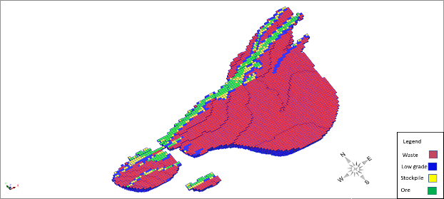
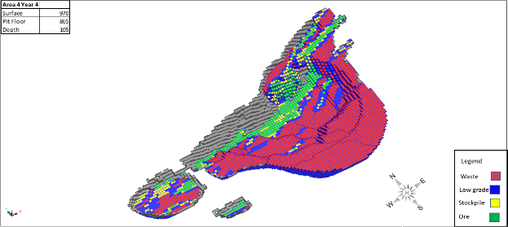
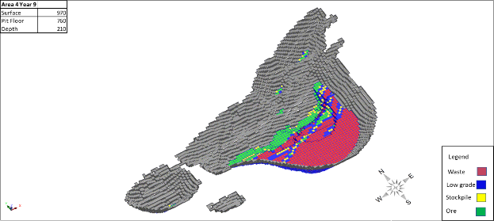
CAPEX and OPEX Lofdal “2B-4”
Mining cost (Waste) | $2.76
Mining cost (Ore) | $2.76
AREA 4 Pit
Year 0
Processing cost per tonne | $28.00
Process recovery | 58.00%
Overheads (Annual) | $12 364 800
Overheads | $6.18
1,300 m
Total Capital Costs Summary (US$)
Direct Mining Costs¹ |  | -
Direct Mine Site Processing Costs |  | 117,577,231
Direct Tailings Storage Facility Costs |  | 13,628,361
SUB TOTAL INITIAL CAPITAL COSTS |  | 131,205,593
Sustaining Capital Mining |  | -
Sustaining Capital Processing |  | 6,010,090
Sustaining Capital Tailings Storage Facility |  | 5,432,266
Mine Closure Costs |  | 5,000,000
Indirect Costs |  | 18,560,082
Contingency |  | 40,873,816
TOTAL CAPITAL COSTS |  | 207,081,846
Year 4
Year 8
¹Mining will be conducted via contractor, all contractor capital recovery is reflected in the operating costs.

Slide 20
PEA Sensitivity Analysis
 | Pre Tax NPV at Range of Operating Costs
Discount | 60% | 70% | 80% | 90% | 100% | 110% | 120% | 130% | 140%
5% | $1004.5M | $911.6M | $818.6M | $725.7M | $632.7M | $539.8M | $446.8M | $353.9M | $261.0M
7% | $822.6M | $744.0M | $665.4M | $586.8M | $508.3M | $429.7M | $351.1M | $272.5M | $193.9M
8% | $745.8M | $673.3M | $600.8M | $528.3M | $455.8M | $383.3M | $310.8M | $238.4M | $165.9M
9% | $676.9M | $609.9M | $542.9M | $475.9M | $408.9M | $341.9M | $274.9M | $207.9M | $140.9M
10% | $615.0M | $552.9M | $490.9M | $428.8M | $366.8M | $304.8M | $242.7M | $180.7M | $118.6M
 | Pre-Tax NPV At Range of Capital Costs
 | $ 124.2 | $ 145.0 | $ 165.7 | $ 186.4 | $207.1M | $ 227.8 | $ 248.5 | $ 269.2 | $ 289.9
Discount | 60% | 70% | 80% | 90% | 100% | 110% | 120% | 130% | 140%
5% | $708.0M | $689.2M | $670.4M | $651.5M | $632.7M | $613.9M | $595.1M | $576.3M | $557.5M
7% | $580.9M | $562.8M | $544.6M | $526.4M | $508.3M | $490.1M | $471.9M | $453.7M | $435.6M
8% | $527.3M | $509.4M | $491.6M | $473.7M | $455.8M | $437.9M | $420.1M | $402.2M | $384.3M
9% | $479.2M | $461.6M | $444.1M | $426.5M | $408.9M | $391.3M | $373.7M | $356.1M | $338.5M
10% | $436.0M | $418.7M | $401.4M | $384.1M | $366.8M | $349.5M | $332.2M | $314.9M | $297.6M
 | Pre-Tax NPV at Basket Price Levels
Discount | $70 | $75 | $80 | $85 | $92 | $95 | $100 | $105 | $110
5% | $240.1M | $330.8M | $421.5M | $512.3M | $632.7M | $693.7M | $784.4M | $883.2M | $965.9M
7% | $177.2M | $253.7M | $330.2M | $406.7M | $508.3M | $559.7M | $636.2M | $719.4M | $789.2M
8% | $150.9M | $221.3M | $291.8M | $362.3M | $455.8M | $503.2M | $573.6M | $650.3M | $714.6M
9% | $127.4M | $192.5M | $257.5M | $322.5M | $408.9M | $452.6M | $517.6M | $588.4M | $647.7M
10% | $106.5M | $166.6M | $226.8M | $286.9M | $366.8M | $407.2M | $467.4M | $532.8M | $587.6M
 | Pre-Tax NPV at Varying Recovery Ranges
Discount | 43% | 48% | 53% | 57% | 59% | 61% | 64% | 69% | 74%
5% | $178.0M | $320.1M | $462.2M | $575.9M | $632.7M | $689.6M | $774.9M | $917.0M | $1059.1M
7% | $124.8M | $244.6M | $364.5M | $460.3M | $508.3M | $556.2M | $628.1M | $747.9M | $867.7M
8% | $102.6M | $213.0M | $323.4M | $411.7M | $455.8M | $500.0M | $566.2M | $676.6M | $787.0M
9% | $82.9M | $184.8M | $286.6M | $368.1M | $408.9M | $449.6M | $510.8M | $612.6M | $714.5M
10% | $65.3M | $159.5M | $253.7M | $329.1M | $366.8M | $404.5M | $461.0M | $555.2M | $649.4M

Slide 21
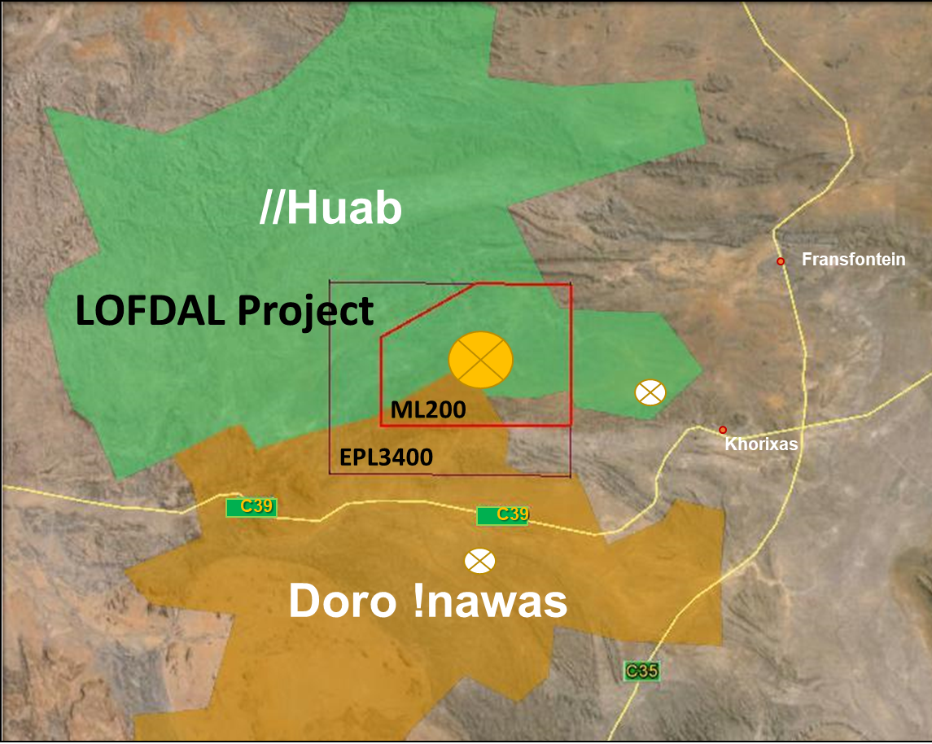
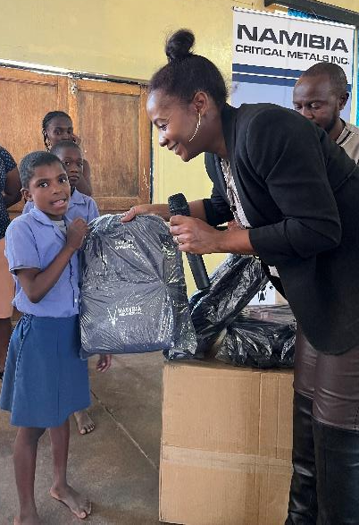
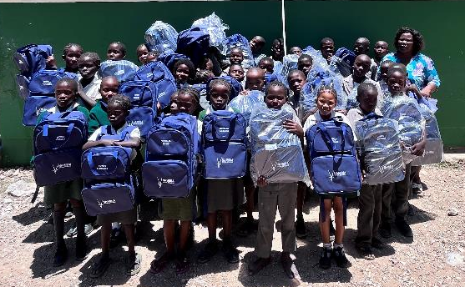
Corporate Social Responsibility (CSR)
The Company expanded its “Early Learner’s Assistance Program” with the start of the 2023 school year. 200 school uniforms and backpacks were handed over twice annually by the Company to five primary schools situated around the Lofdal project.
Program model copied from our corporate shareholder, Bannerman Energy, for which they were awarded this years’ Mining Indaba ESG Forum Award for Community Engagement.”
Regular meetings with the two Traditional Authorities Huab and Doro !nawas
Long-term support of local communities with water supply: borehole equipment and maintenance
Regular meeting with the Governor of Kunene Region for coordination of activities

Slide 22

Development Plan
Optimization of flotation (finer particle size for higher recoveries, reagent consumption, generic reagents) (SGS)
Tests of XRT sorting to upgrade low grade/stockpile material (TOMRA)
Locked cycle processing tests on bulk sample (Anzaplan or SGS)
Infill drilling for required upgrade in Resource Categories (GEX/MSA)
Update EIA based on 1 year monitoring data and PEA “2B-4” (SLR)
Blast for starter pit at Area 4
Mineral Resource Statement
PEA „Lofdal 2B-4“
for 2.1 Mt/a over
16 years
JV agreement with JOGMEC
Completion PFS
Completion
DFS
2020
2021
2022
2023
2024
2025
2026
Pre-2020 Exploration by NRE/NMI
expenditure CAD$24M
Grant of Mining License
ML 200 for 25 years
Geotechnical drilling
Drilling 8,000 m RC
Flotation pilot test
Drilling 6,000 m DC
Variability testing
Resource update
Infill drilling RC
Optimization flotation
Completion EIA „2B-4“

Slide 23
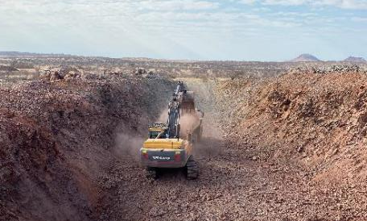
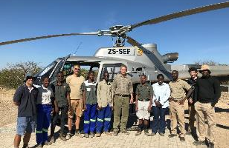

Summary & Opportunities
Strategic investment of global significance: One of the few very large HREE mineral resource projects with simple mineralogy outside China
Planned production of about 5% of global demand: 17 t/a Tb and 117 t/a Dysprosium (“Lofdal 2B-4” at 2.1 Mt/a)
Significant resource potential → Possible upscale to 3 Mt/a and life of mine >16 years
  Additional open pit satellite deposits
  Underground mining for deeper ore bodies
  Sorting technology to upgrade low-grade/stockpile grades and lowering cut-off grade
Fully licensed: Mining Licence issued for 25 years
Environmental Clearance Certificate issued for mine and infrastructure corridor
Fully JOGMEC-funded PFS underway with pilot-scale test work at SGS
ESG program rolled out and strengthened
Highly experienced project team in Namibia
Strong support from Japanese Government through JOGMEC JV to develop Lofdal mine
Possible REE separation plant in Namibia through Rare Earth Alliance Namibia
Dy
Tb
Dysprosium
Terbium

